Slide 1
Sprint one: Review
Group 15: William B, Jonas R, CJ. H, Jake C. and tom V.C.

Slide 2

Roles:
Scrum Master: CJ (prior experience scrum/ agile dev)
Product Owner: Tom V.C.
Development Team:
Group 15

Slide 3
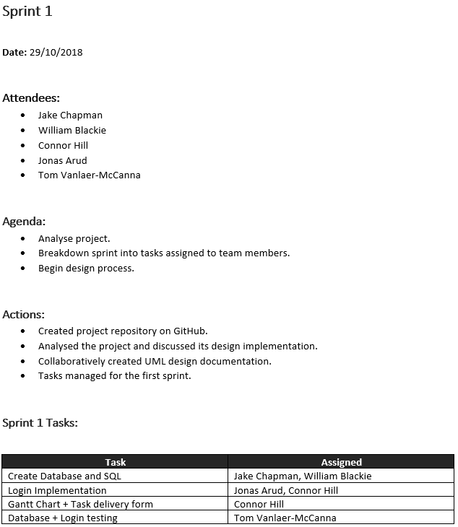
Scrum Meetings: minutes
Begin to identify project creation needs and task requirements
Maintain projects development cycle

Slide 4
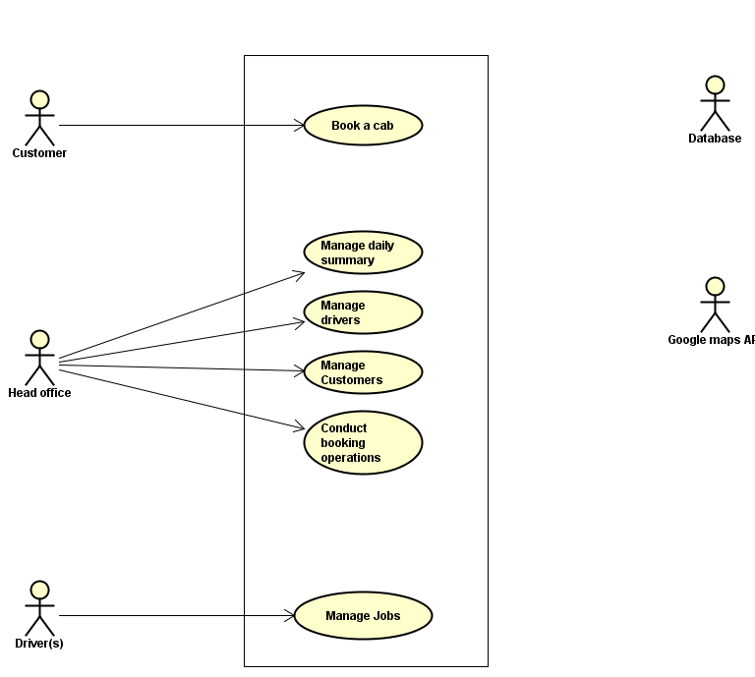
Tasks: Identification
As a team we created UML high and low level use case for all actors:

Slide 5
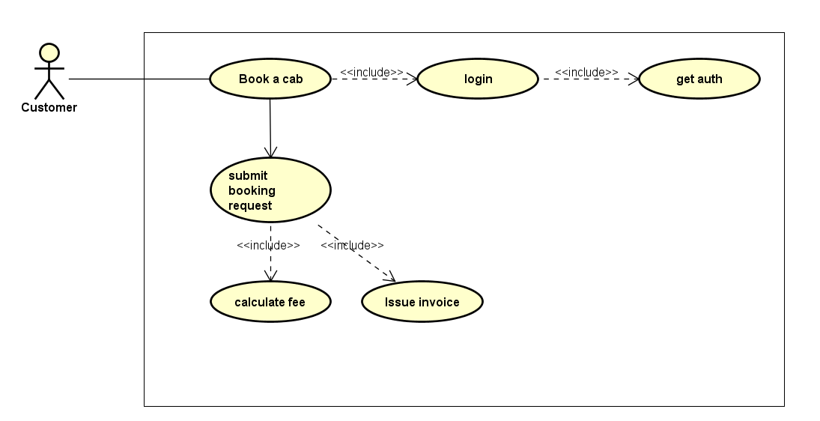
Task assignment
Using the low level user cases we identified the needs of the first sprint and the base requirements to produce a working product: Example single use case for customer:

Slide 6
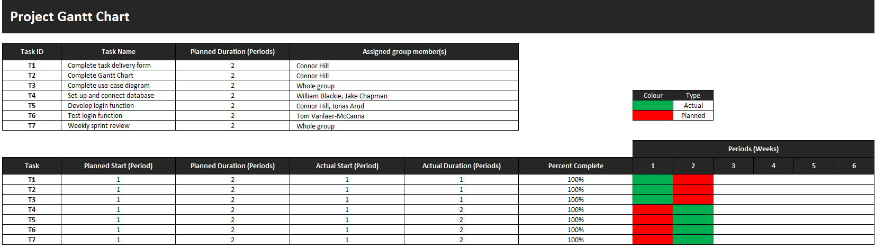
Task schedule
Using the use cases to identify the minimum requirements of creating the first deliverable, we needed to implement a functional database as well as validation of login which were distributed according to experience.

Slide 7
Task overview: Database

Slide 8
Task overview: Login

Slide 9
Task overview: Testing/ Validation
ID | Input | Expected Result | Actual Result | Notes
Admin1 | User: Admin, Pass: password | Redirect to invalidLogin.jsp | Redirect to invalidLogin.jsp | Form correctly checks for inputs.
Admin2 | User: gqrekovsky16@yopmail.com, Pass: a123 | Redirect to userLogged.jsp with “Welcome Mathias Sibman” header. | Redirect to userLogged.jsp with “Welcome Mathias Sibman” header. | Admin user 1 works correctly.
Admin3 | User: gqrekovsky16@yopmail.com, Pass: A123 | Redirect to invalidLogin.jsp | Redirect to invalidLogin.jsp | Form correctly checks for case sensitive passwords.
Admin4 | User: ingerk13@yopmail.com, Pass: a234 | Redirect to userLogged.jsp with “Welcome Benjamin Hubert” header. | Redirect to userLogged.jsp with “Welcome Benjamin Hubert” header. | Admin user 2 works correctly.
Admin5 | User: bjebbe9@yopmail.com, Pass: a2345 | Redirect to userLogged.jsp with “Welcome Ebbe Streme” header. | Redirect to userLogged.jsp with “Welcome Ebbe Streme” header. | Admin user 3 works correctly.
Admin6 | User: bjebbe9@yopmail.com, Pass: a123 | Redirect to invalidLogin.jsp | Redirect to invalidLogin.jsp | Form is correctly matching passwords to usernames, cannot mix and match admin user/pass.

Slide 10
Project Management
Communications: Facebook group chat and weekly Scrum meet.
Peer review before merging changes
Clear layout of tasks using UML as the basis.
Roles are based on skills of team members.
Minutes of meeting taken to track development cycle.
Strict code of practice for version control to maintain project integrity.
Product owner role utilised throughout for feedback, product owner involved in testing for optimal feedback.

Slide 11
Developmental obstacles
Git issues: some members were not fully adept at git VCS, to address this they were shown the proper procedure after scrum meetings where the issue was found. This confirms our decision to hold weekly scrum meetings to allow us to identify and resolve any issues prior to sprint completion. This prevents minor issues becoming larger issues later in development and allow us to stick to our sprint schedule.
As of sprint one only small issues were encountered; due to effective planning and role allocation.

